Slide 1
An Introduction to Proximal Algorithms
Lama Affara
September 22, 2016
Reference: Parikh&Boyd: Proximal Algorithms, Foundations and Trends in Optimization

Slide 2
Why Proximal Algorithms?
solving convex optimization problems
Newton’s method
unconstrained
smooth
modest size
Proximal Algorithms
constrained
Non-smooth
large scale
distributed

Slide 3
Outline
Proximal Operator
Definition
Properties
Evaluation
Proximal Algorithms
Relationship to Augmented Lagrangian
ADMM

Slide 4
What is a Proximal Operator?

Slide 5
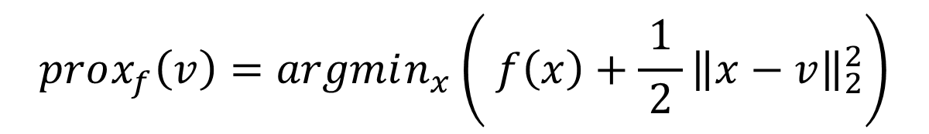
What is a Proximal Operator?
Definition let f be a convex function. The proximal operator of f is defined as
$$prox_{f}\left(v\right)=argmin_{x}\left( f\left(x\right)+\frac{1}{ 2 }{\left\|x−v\right\|}_{2}^{2}\right)$$

Slide 6
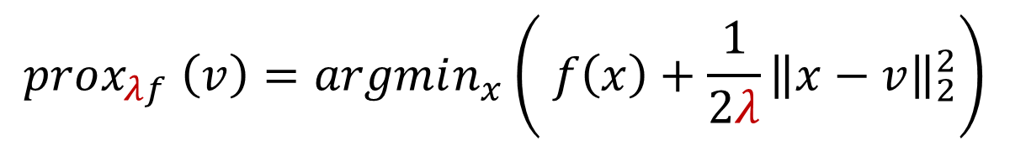
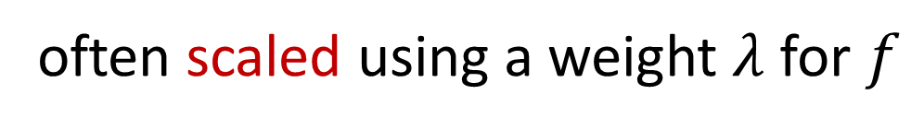
What is a Proximal Operator?
Definition let f be a convex function. The proximal operator of f is defined as
$$prox_{λf} \left(v\right)=argmin_{x}\left( f\left(x\right)+\frac{1}{2λ}{\left\|x−v\right\|}_{2}^{2}\right)$$
often scaled using a weight $λ$ for $f$

Slide 7
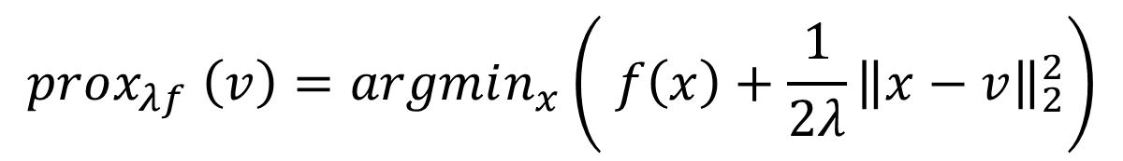

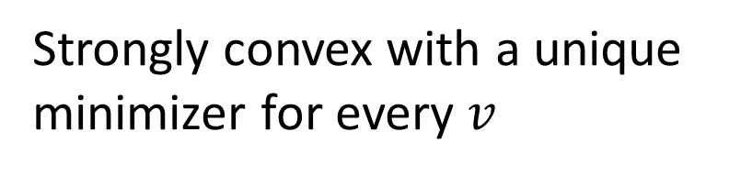
What is a Proximal Operator?
$$prox_{λf} \left(v\right)=argmin_{x}\left( f\left(x\right)+\frac{1}{2λ}{\left\|x−v\right\|}_{2}^{2}\right)$$
Strongly convex with a unique
minimizer for every $v$
even if $f$ is only weakly convex

Slide 8
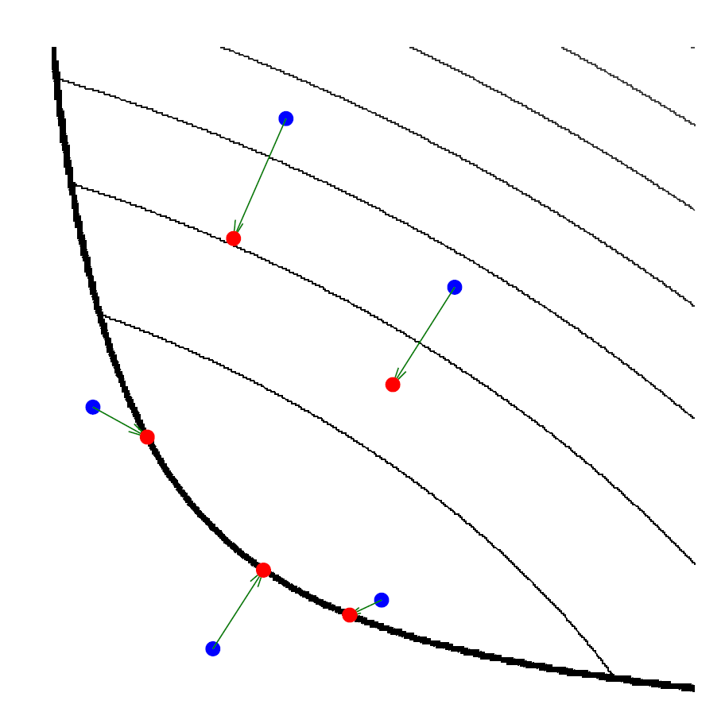
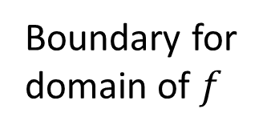
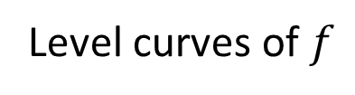
What is a Proximal Operator?
$$prox_{λf} \left(v\right)=argmin_{x}\left( f\left(x\right)+\frac{1}{2λ}{\left\|x−v\right\|}_{2}^{2}\right)$$
Level curves of $f$
Boundary for
domain of $f$

Slide 9
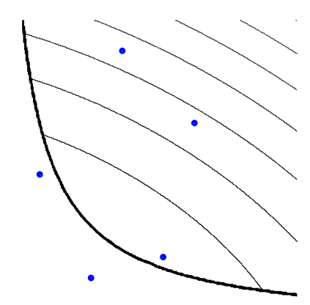
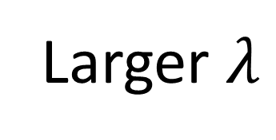
What is a Proximal Operator?
$$prox_{λf} \left(v\right)=argmin_{x}\left( f\left(x\right)+\frac{1}{2λ}{\left\|x−v\right\|}_{2}^{2}\right)$$
Larger $λ$

Slide 10
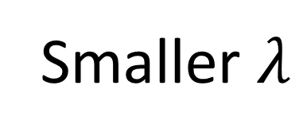
What is a Proximal Operator?
$$prox_{λf} \left(v\right)=argmin_{x}\left( f\left(x\right)+\frac{1}{2λ}{\left\|x−v\right\|}_{2}^{2}\right)$$
Smaller $λ$

Slide 11

What is a Proximal Operator?
The proximal operator minimizes $f$ while staying close to a reference point $v$
$prox_{f}\left(v\right)$ → proximal point of $v$ with respect to $f$

Slide 12
Proximal Operator Properties

Slide 13
Separability
Evaluating the proximal operator of a separable function reduces to evaluating the proximal operator for each of the separable parts

Slide 14
Basic Operations
Post-composition
Pre-composition

Slide 15

Fixed Points
$x$ is a fixed point of the proximal operator
$x$ is also a minimizer of $f$

Slide 16
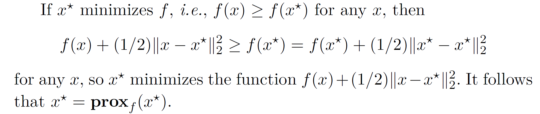
Proof

Slide 17
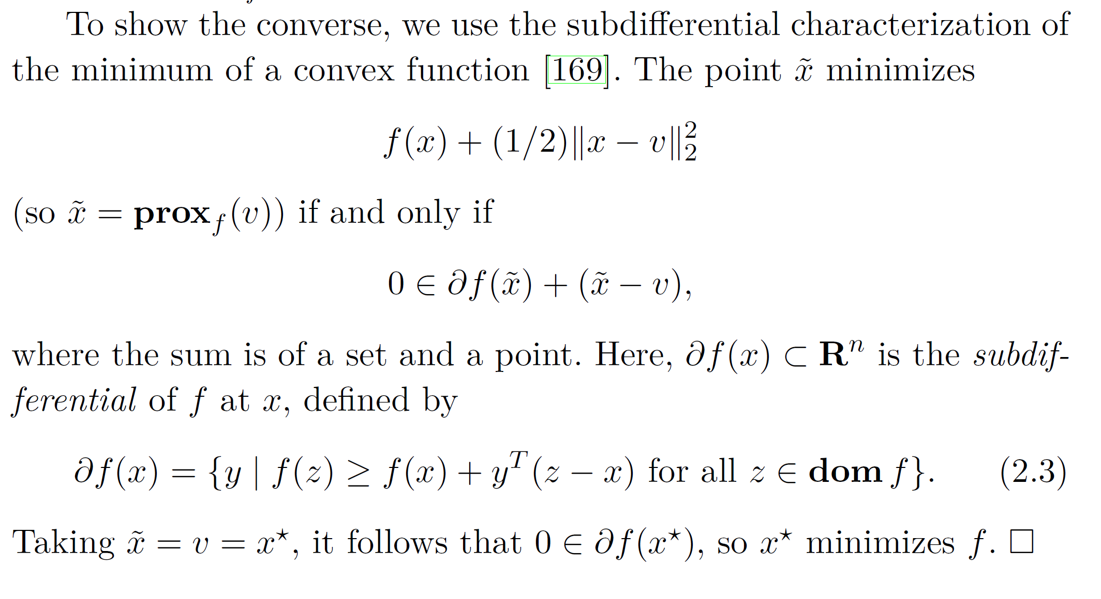
Proof

Slide 18
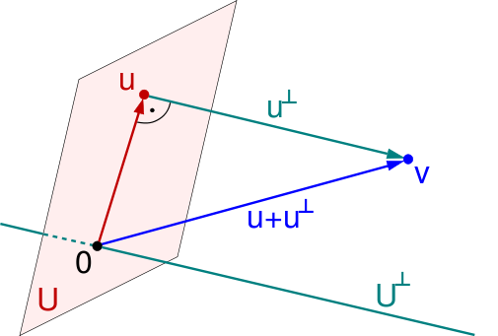

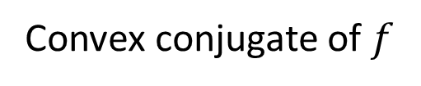
Moreau Decomposition
$$v=prox_{f}\left(v\right)+prox_{f^{∗}}(v)$$
$$f^{∗}=\sup_{x}{(y^{T}x−f(x))}$$
Convex conjugate of $f$

Slide 19
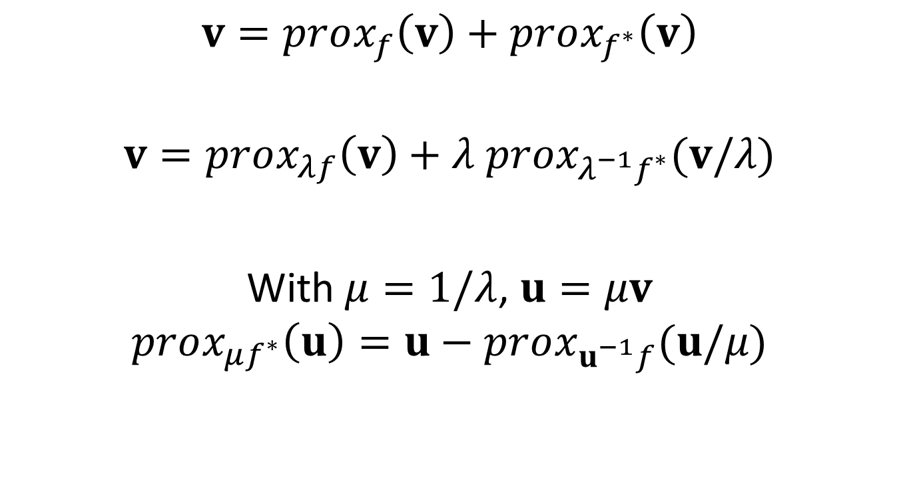
Moreau Decomposition
$$v=prox_{f}\left(v\right)+prox_{f^{∗}}\left(v\right)$$
$$v=prox_{λf}\left(v\right)+λ prox_{λ^{−1}f^{∗}}(v/λ)$$
With $μ=1/λ$, $u=μv$
$$prox_{μf^{∗}}\left(u\right)=u−prox_{u^{−1}f}(u/μ)$$

Slide 20

Connection to Gradient Methods
For small $λ$ and differentiable $f$
$$prox_{f}\left(v\right)≈v−λ ∇f(v)$$
step size

Slide 21
Proximal Operators for common functions

Slide 22

Linear Least Square (LLS) problem
$$f\left(x\right)=\frac{1}{2}{\left\|Ax−b\right\|}_{2}^{2}$$
Notes:
Note: even if A is not full rank, the inverse in the proximal operator is well conditioned for appropriate choices of λ

Slide 23
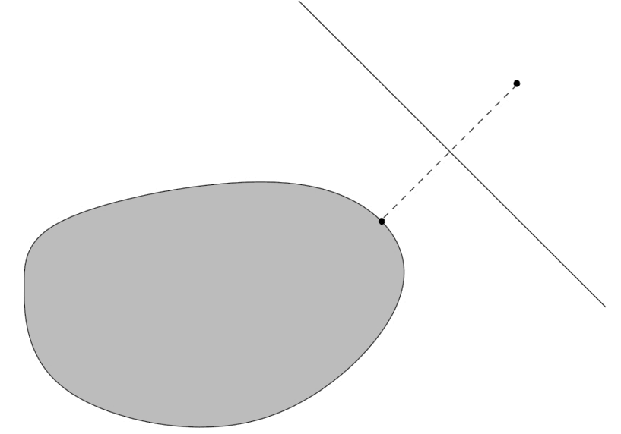



Indicator Function
$$f\left(x\right)=I_{C}(x)=\left\{\begin{matrix}\begin{matrix}0 & x∈C\end{matrix} \\ \begin{matrix}+∞ & x∉C\end{matrix}\end{matrix}\right.$$
$$v$$
$$C$$

Slide 24


Indicator Function
Example: non-negative solutions
$$C$$
$$0$$

Slide 25
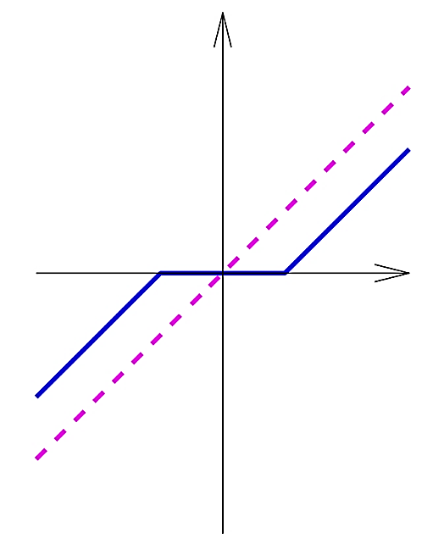





$L_{1}$ Norm
$$f\left(x\right)={\left\|x\right\|}_{1}$$
$$−ε$$
$$ε$$
$$x$$

Slide 26


$L_{p}$ Norm
$$f\left(x\right)={\left\|x\right\|}_{p}$$

Slide 27
Proximal Algorithms

Slide 28
Proximal Algorithms
Solve a convex optimization problem using proximal operators of the objective terms
Most useful when proximal operators can be evaluated quickly

Slide 29

Proximal Minimization
$$x^{k+1}≔prox_{λf}(x_{k})$$
Uses the fixed point property of the proximal operator
The LS proximity term in the operator acts as a regularizer for f that vanishes as we approach a solution

Slide 30

Proximal Gradient Method
$$\min_{x}{f\left(x\right)+g\left(x\right)}$$
$$x^{k+1}≔prox_{λ^{k}g}\left(x^{k}−λ∇f\left(x^{k}\right)\right)$$
differentiable

Slide 31
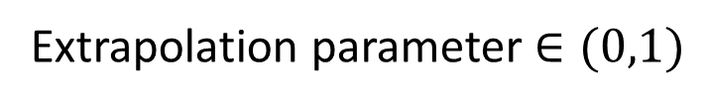

Accelerated Proximal Gradient Method
$$\min_{x}{f\left(x\right)+g\left(x\right)}$$
$$y^{k+1}≔x^{k}+w^{k}(x^{k}−x^{k−1})$$
$$x^{k+1}≔prox_{λ^{k}g}\left(y^{k+1}−λ∇f\left(y^{k+1}\right)\right)$$
Extrapolation parameter $∈(0,1)$

Slide 32

ADMM
$$\min_{x}{f\left(x\right)+g\left(x\right)}$$
$$\min_{x,z}{f\left(x\right)+g(z)}$$
s.t. $x=z$
ADMM
Algorithm

Slide 33
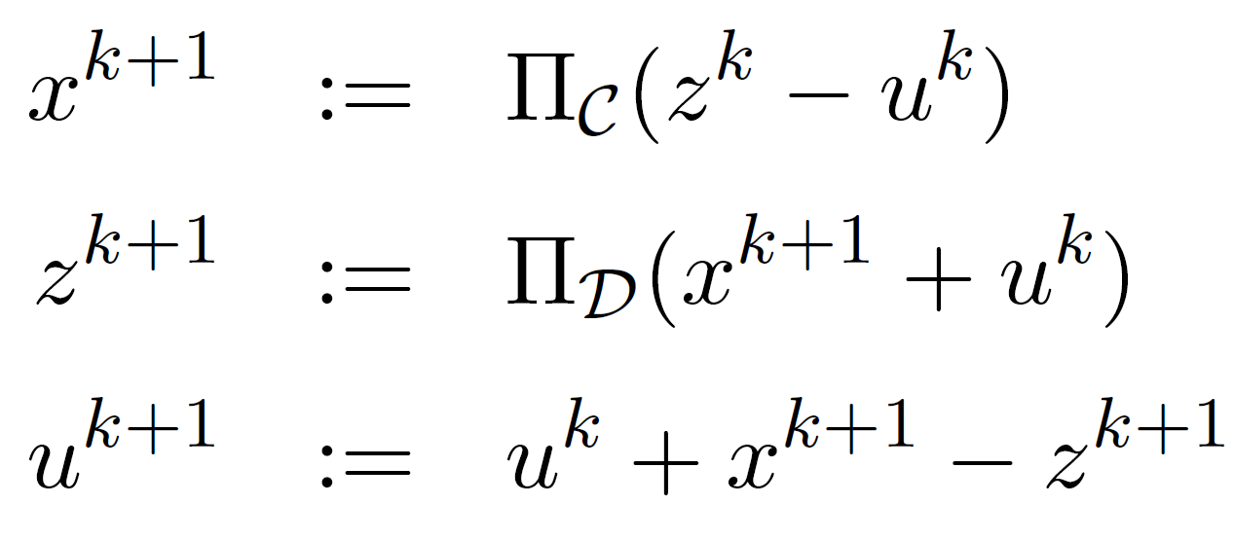

Example
f is the indicator function of a convex set $C$
g is the indicator function of a convex set $D$
Notes:
The problem of minimizing f + g is then equivalent to the convex feasibility problem of finding a point x ∈ C ∩ D.

Slide 34
Augmented Lagrangian
Augmented Lagrangian:
ADMM:

Slide 35
Augmented Lagrangian
Expand:

Slide 36
Augmented Lagrangian
Combine linear and quadratic terms:

Slide 37
Augmented Lagrangian
To convert to proximal form, substitute
into

Slide 38
Augmented Lagrangian
More general problems
Two approaches
1) roll the matrix into g
2) generalize the consensus constraint

Slide 39
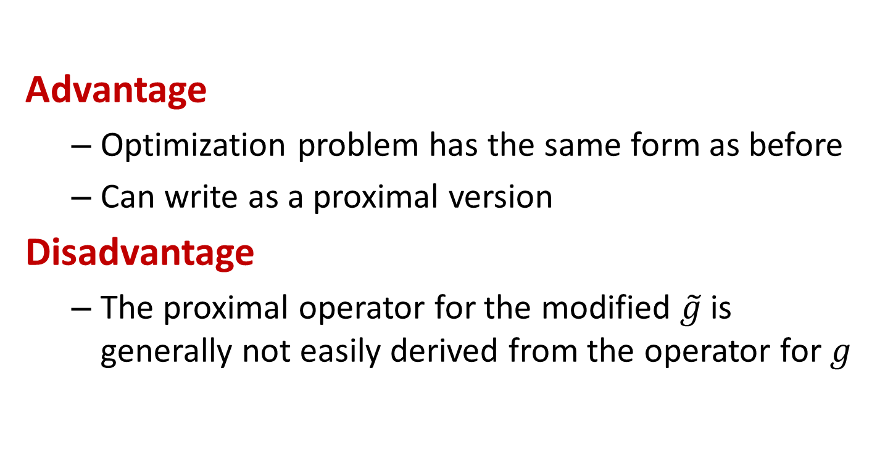
Approach 1
Advantage
Optimization problem has the same form as before
Can write as a proximal version
Disadvantage
The proximal operator for the modified $\tilde{g}$is generally not easily derived from the operator for $g$

Slide 40
Approach 2
Augmented Lagrangian:
ADMM:
Notes:
But: the first subproblem is now a mix of both terms from the original problem

Slide 41
Linearized ADMM
linearize the quadratic term as
This leads to the following proximal algorithm:
Notes:
To restore the independence of f and g, we linearize the quadratic term

Slide 42
First-order Primal Dual
First-order Primal-Dual [Chambolle&Pock]:
convex
conjugate
Notes:
can use the Moreau decomposition to obtain this proximal operator
Finding γ, τ can be costly; wrong estimates can lead to non-convergence
Whether this algorithm is significantly faster than ADMM in practice depends on the specific problem

Slide 43
Proximal Algorithms
Work under general conditions
Can be fast
Amenable to distributed optimization
Conceptually and mathematically simple
Many variations on the presented methods

Slide 44
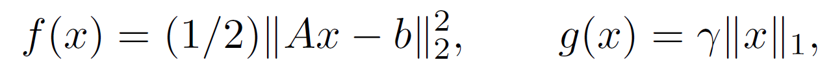

Example: LASSO
Proximal gradient method
$$x^{k+1}≔prox_{λ^{k}g}\left(x^{k}−λ∇f\left(x^{k}\right)\right)$$
matrix vector multiplications
negligible
Iterative Shrinkage-Thresholding Algorithm (ISTA)

Slide 45
Example: LASSO
ADMM method
Solving a linear system
Shrinkage
Notes:
we can use factorization caching. This does mean, however, that the parameter λ must be kept fixed.

Slide 46
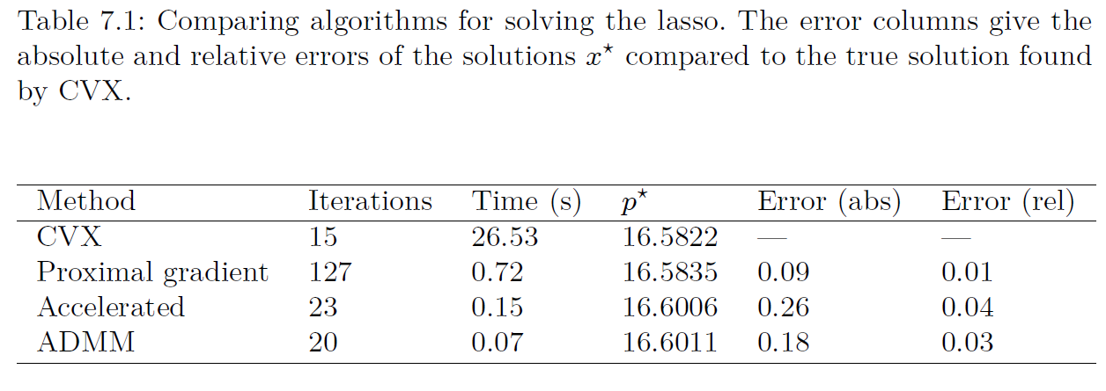
Example: LASSO

Slide 47
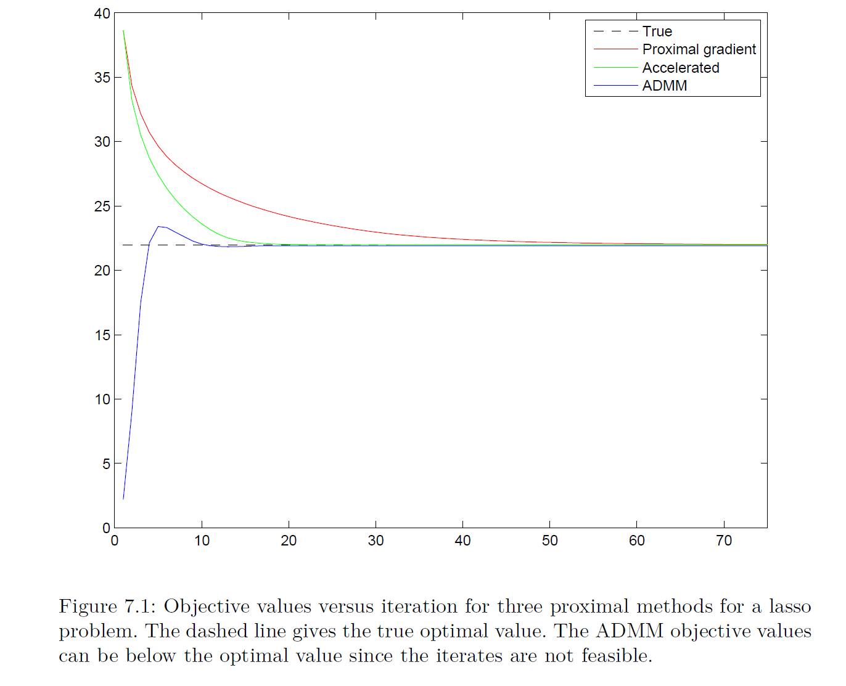
Example: LASSO

Slide 48
Thank You

